Slide 1



Welcome To Our Presentation
Flight Management System
Our Members
Shivnath Mahato
Nikita Sah
Anoushka Karki
Sushana Sharma

Slide 2
Core
Python 3
Tkinter, Matplotlib,seaborn

Slide 3


Interface Flow
Login
Book/Edit/View
Store Updates
Logout

Slide 4
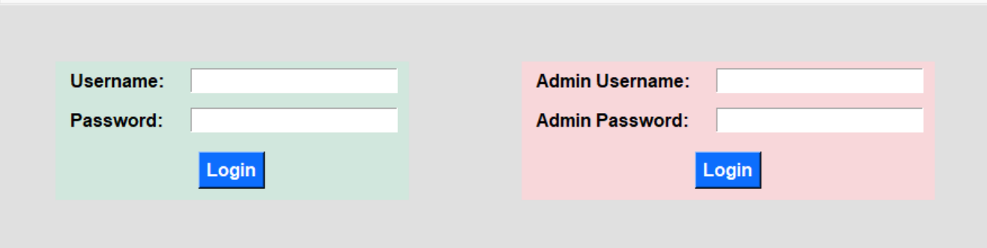
Login View
# Default Credentials
admin:admin
user:user

Slide 5
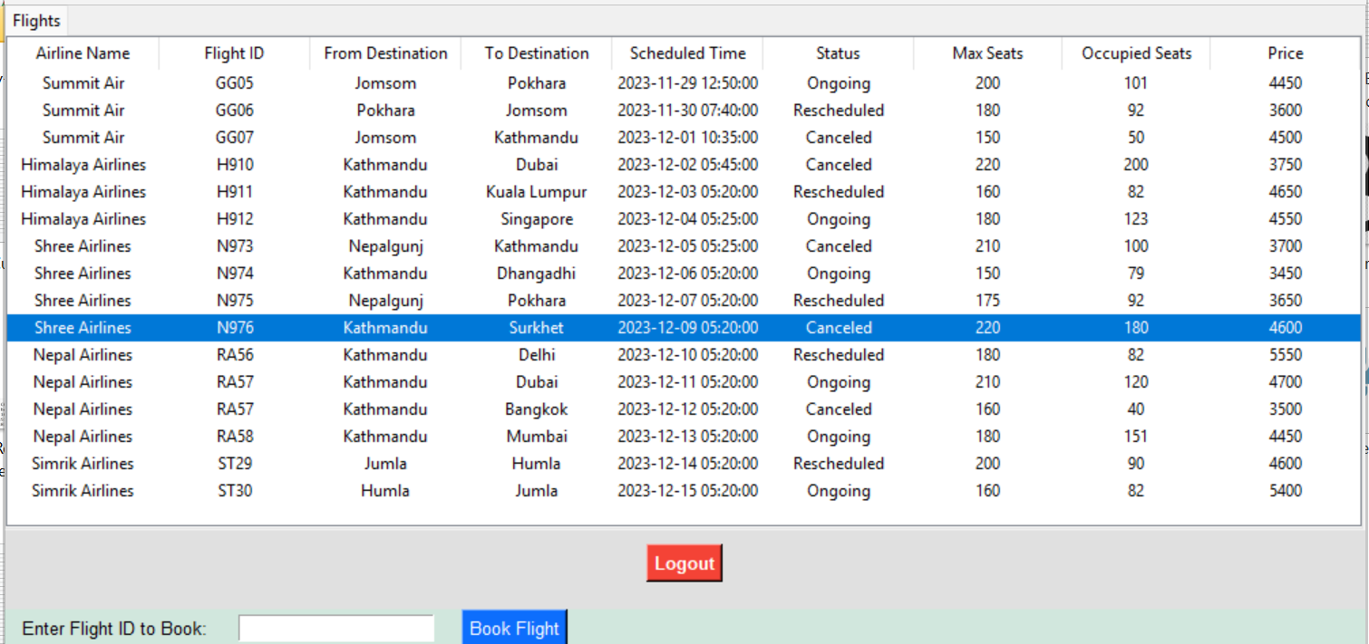
User View

Slide 6
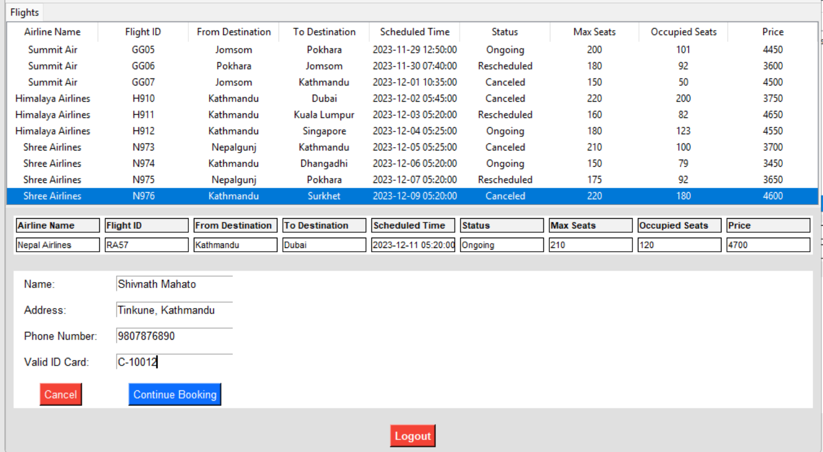
User Booking View

Slide 7
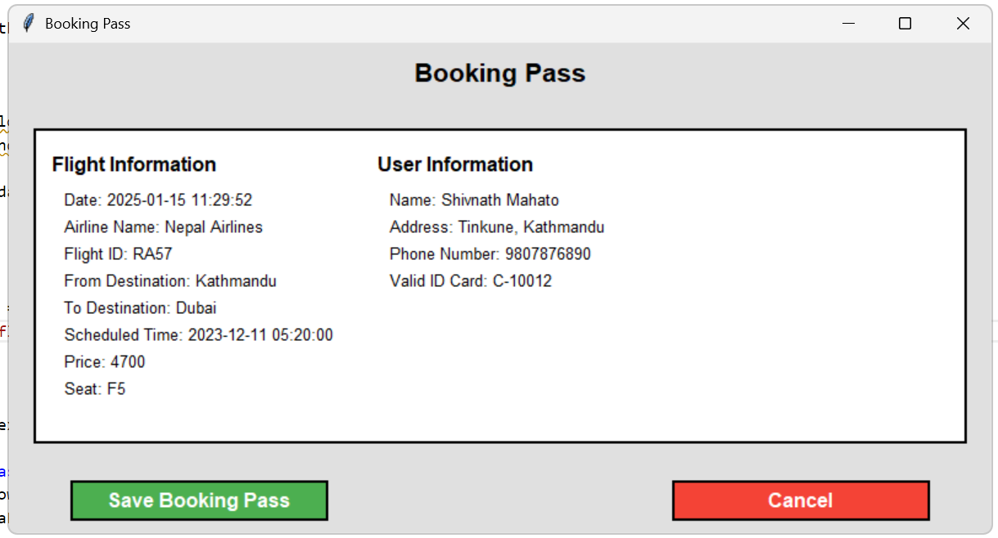
Booking Pass View

Slide 8
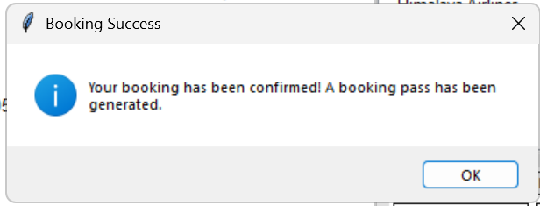
Booking Confirmed View

Slide 9
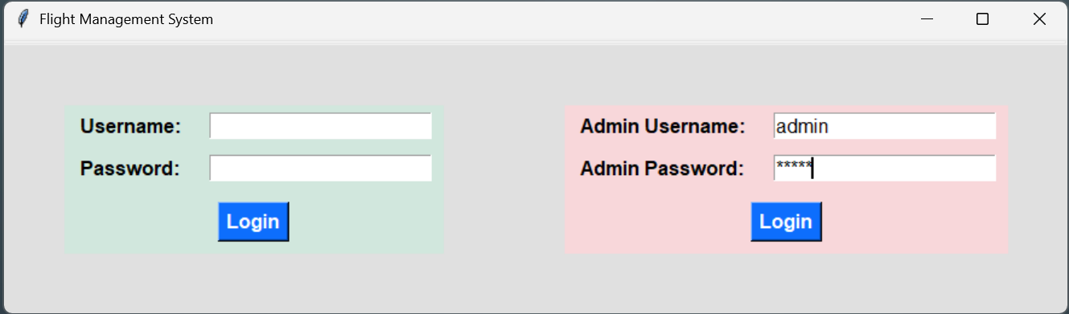
Logout Login View

Slide 10
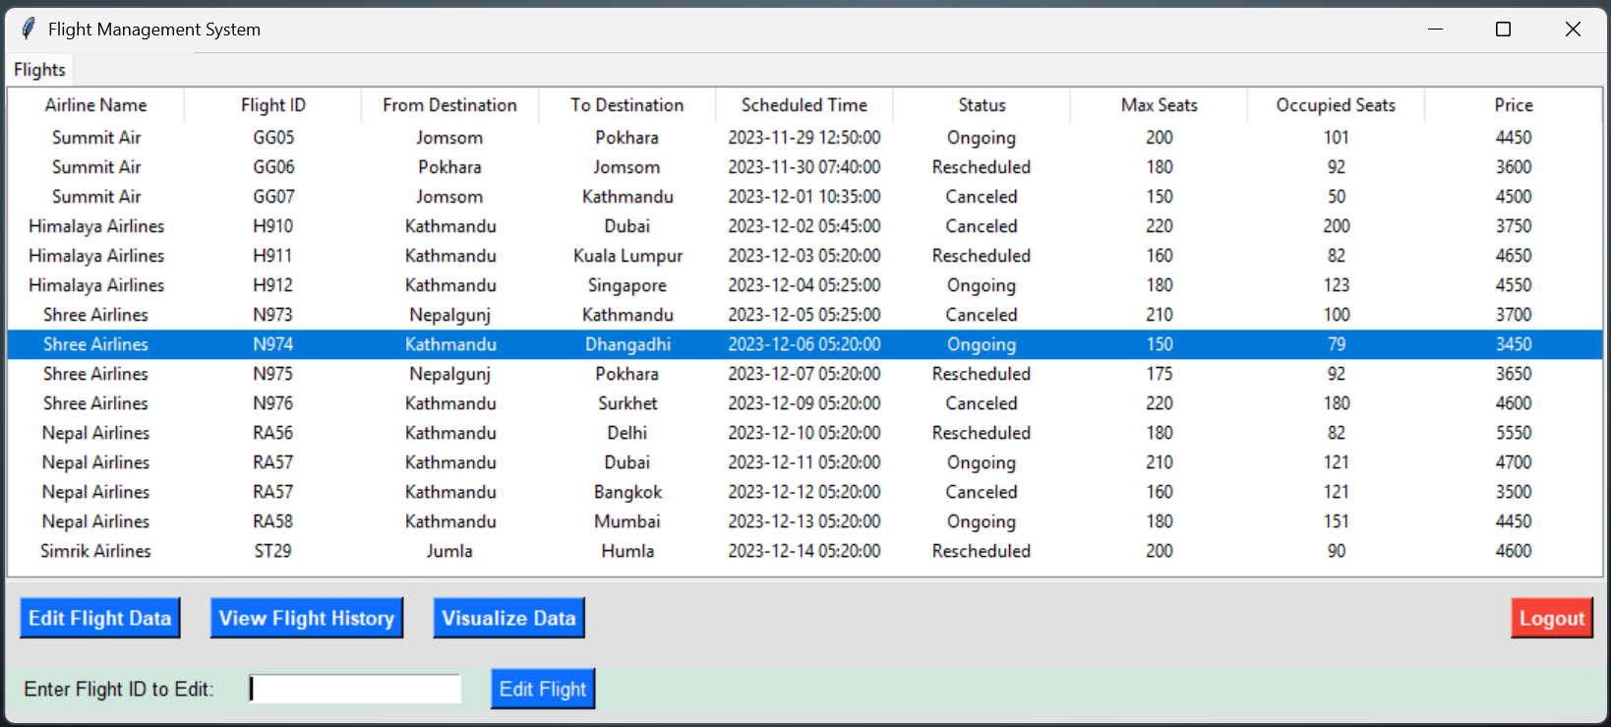
Admin Initial View

Slide 11
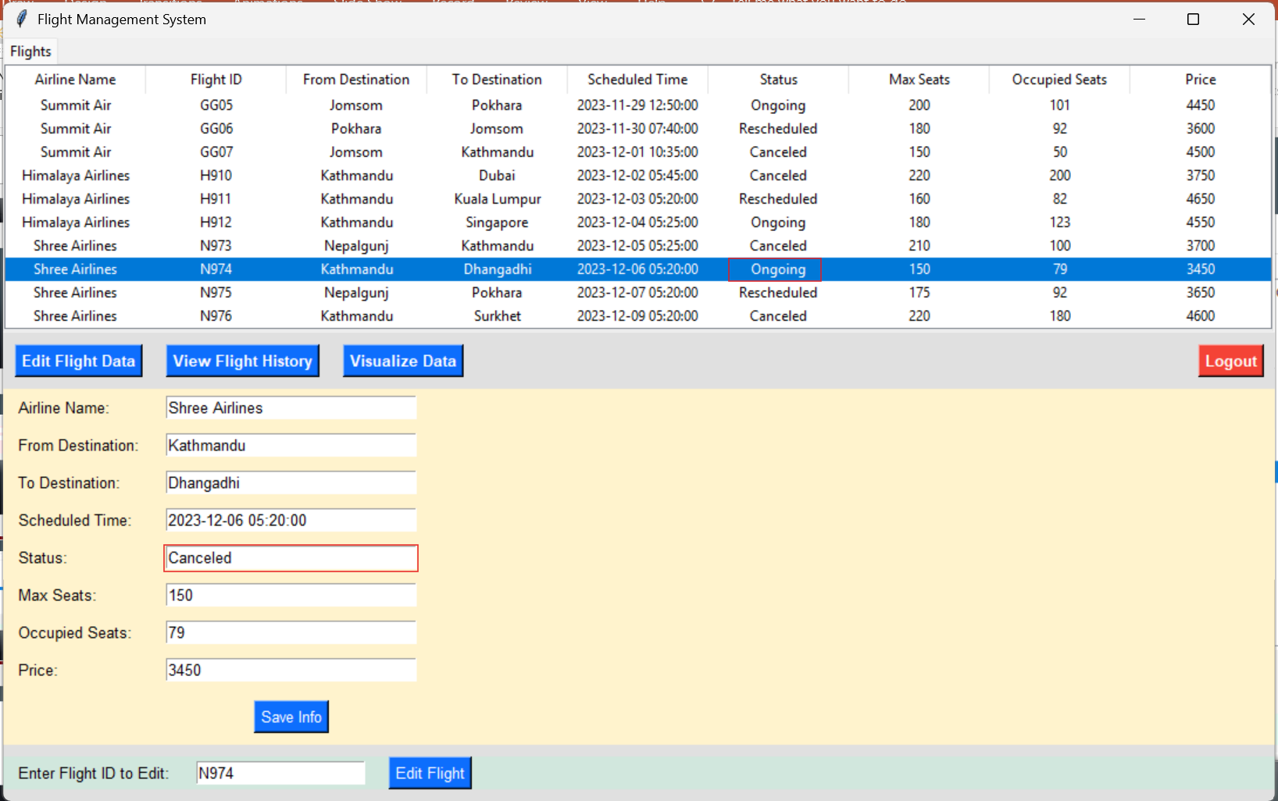
Admin Edit Flight View

Slide 12
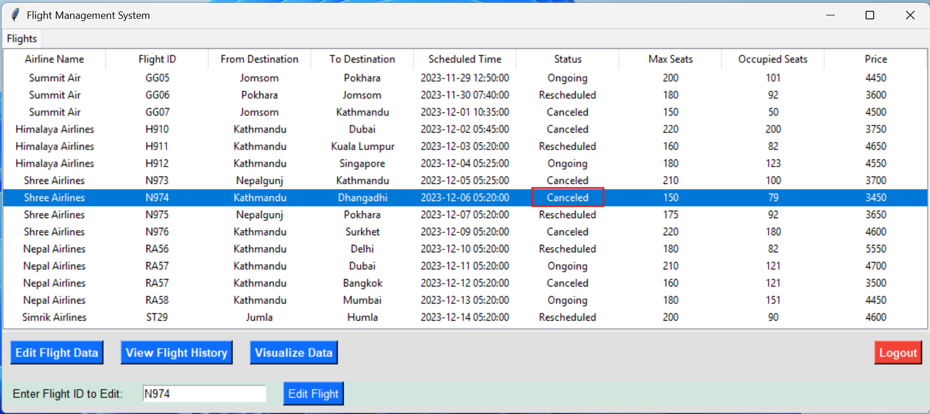
Admin Initial View

Slide 13
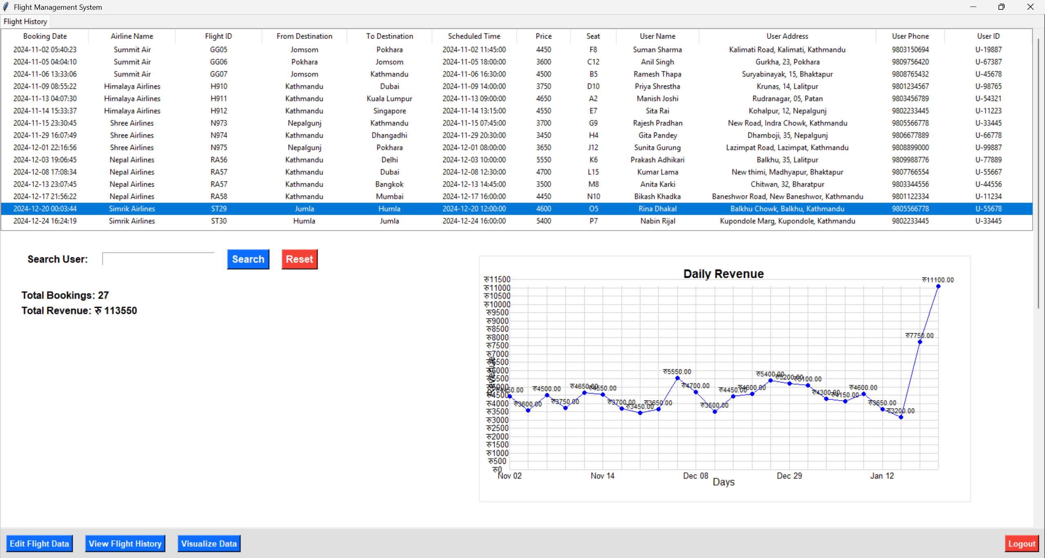
Admin Flight History and Revenue graph View

Slide 14
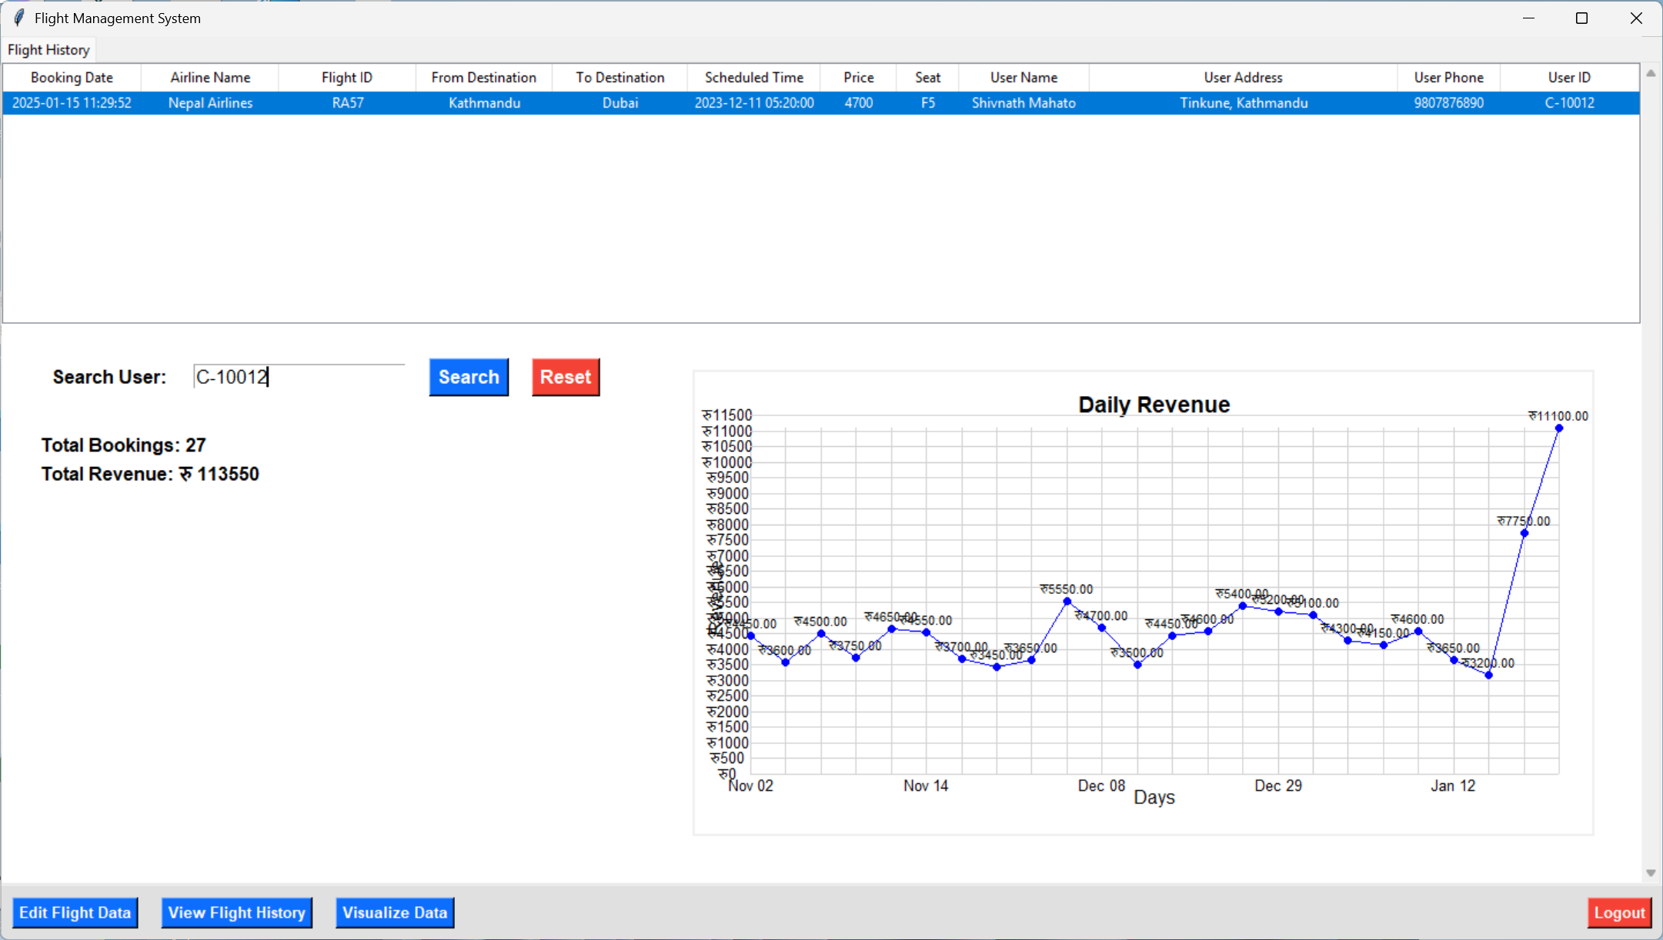
Admin Search user View

Slide 15
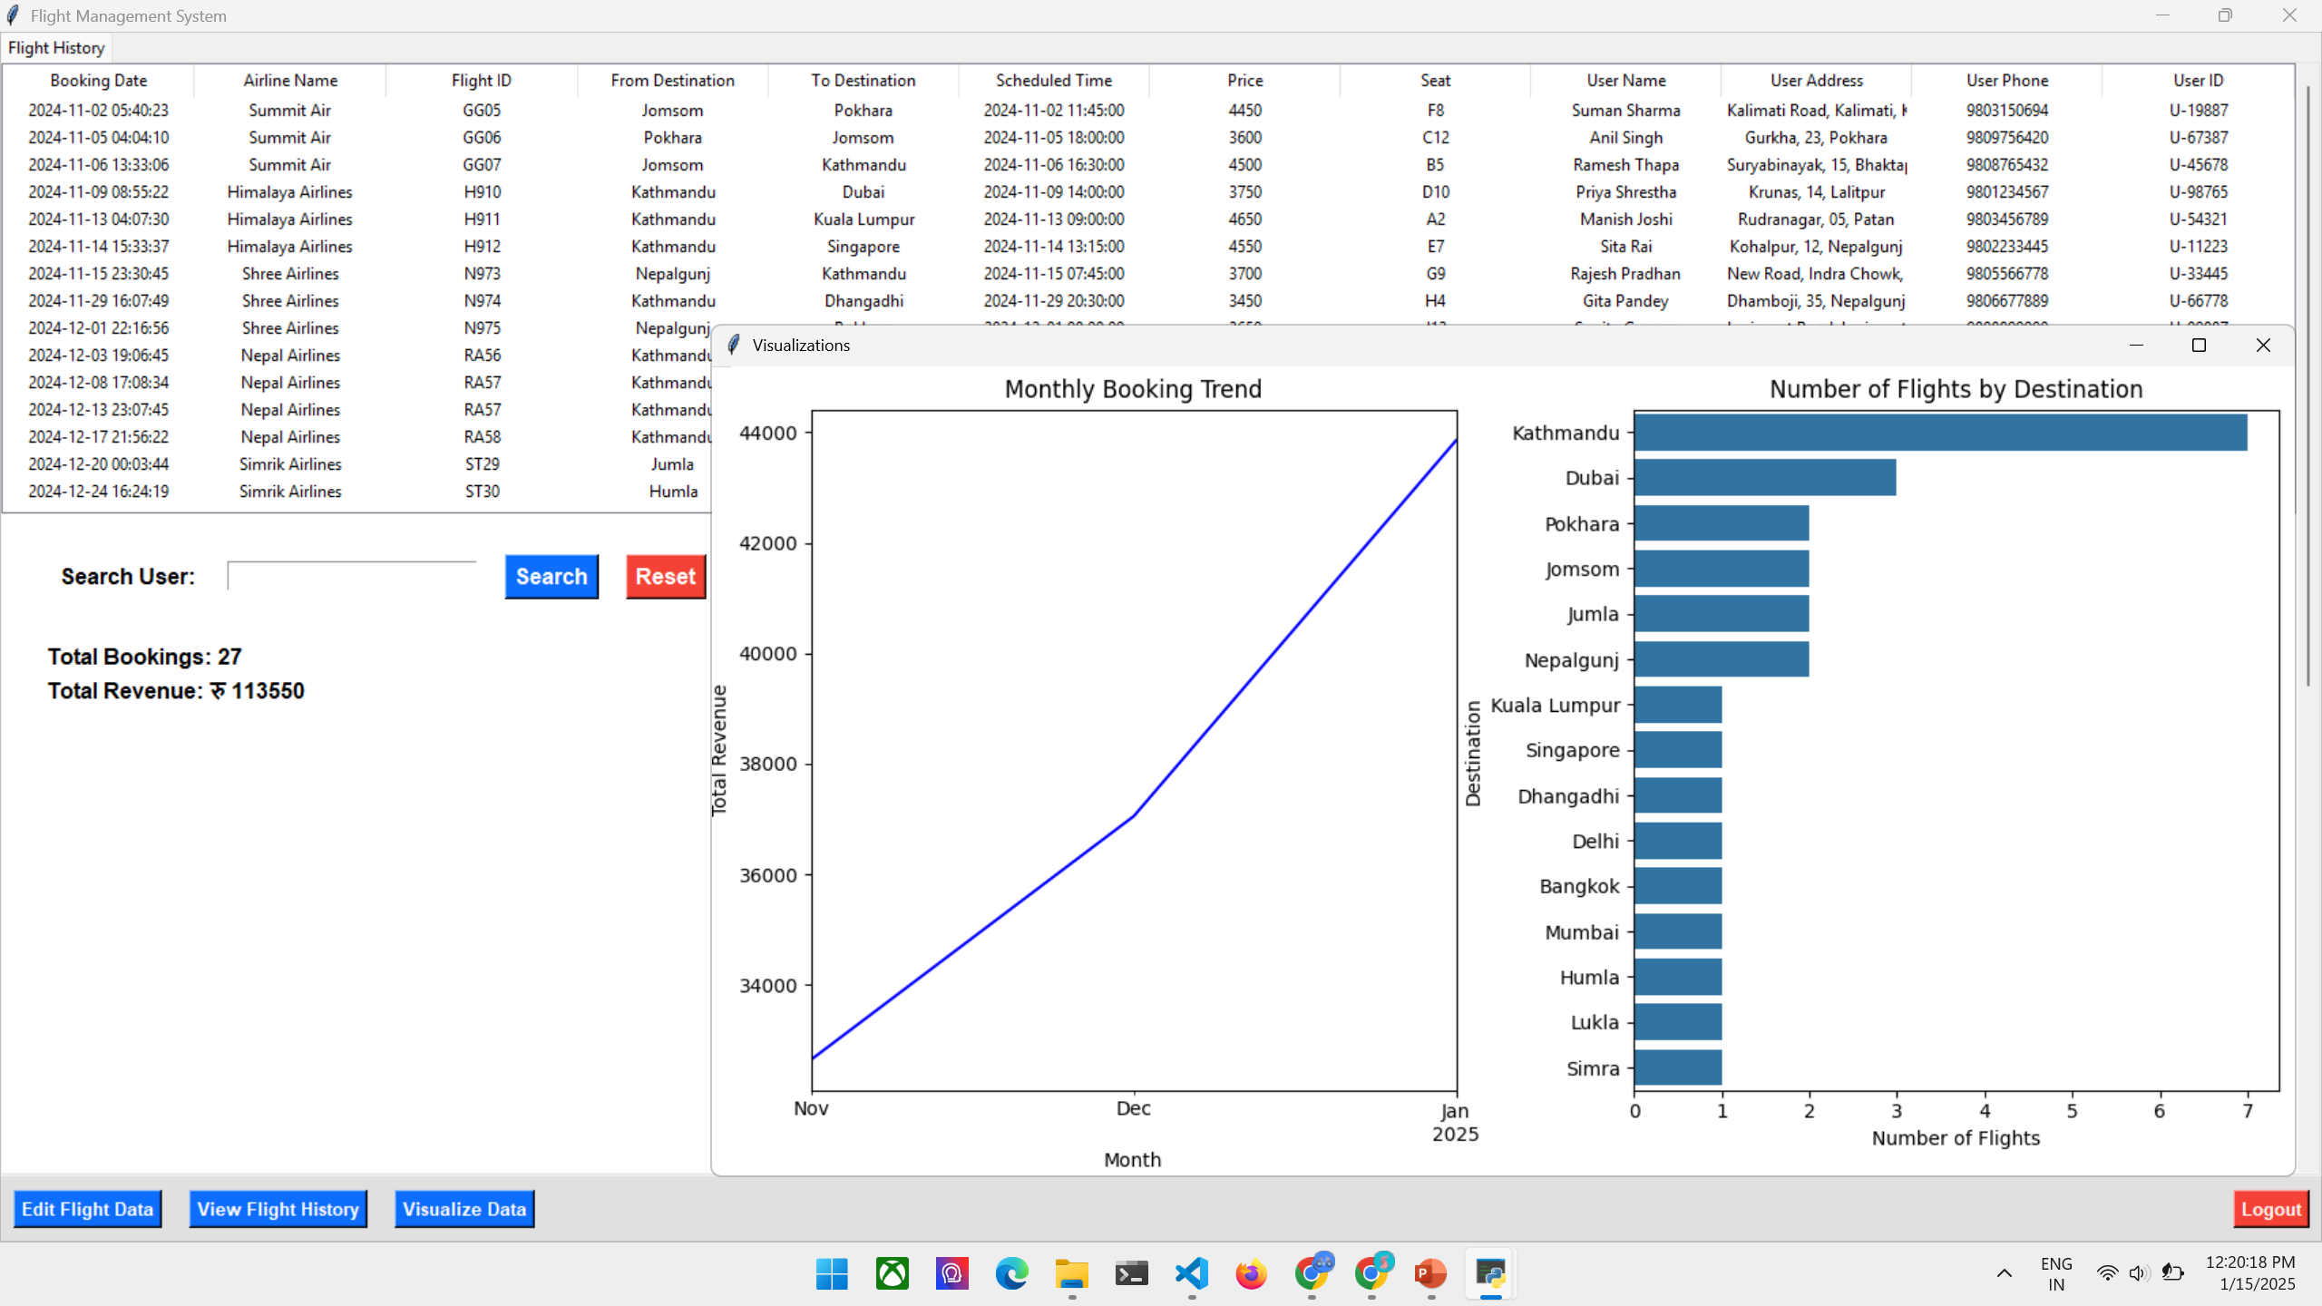
Admin Visualize Flight History View

Slide 16
Logout Anytime View

Slide 17


